Slide 1


Slide 2
Surface Fire in Coalfields

Slide 3
Most prominent examples of surface fire are Jharia and Raniganj coalfields fires.
These fires started in the twenties or thirties and still continue to burn.
In Jharia coalfields, there are about 70 surface fires covering an area of 17 km² blocking about 48 MT of coal.
They also cause serious environmental pollution.

Slide 4
Causes of surface fires
Caused due to ignition of
(a) coal refuse banks, piles or heaps comprising rejected mine dirts, washery rejects, boiler ash and other discarded materials.
(b) coal stacks stockpiled at random.
(c) outcrops of seams, and
(d) quarry overburden dumps with high carbonaceous material.

Slide 5
Possible causes of ignition are
Spontaneous combustion (the most common cause).
Careless burning of trash or garbage from nearby dwellings.
Burning of dried vegetation if not insulated from the refuse pile.
Underground fires in shallow mines reaching the surface through cracks due to subsidence.
Dumping of hot ashes.
Intentional ignition.

Slide 6
COAL REFUSE FIRES

Slide 7
Prevention of coal refuse fires
Selecting suitable coal refuse site.
  A flat, gently sloping site is satisfactory.
Compacting refuse materials by dozer, rollers, scraper, truck and front end loader.
After compaction, providing a sealing layer of inert material of not more than 60 cm in thickness with an impervious seal at edges.
Prohibiting placement of flammable materials (wood dust, waste oil, oily rags, greases, paints etc.) on the pile.
Quenching boiler ashes before disposition on the pile.
Regular inspection of pile to detect fumes, smell of gases, etc.

Slide 8
Fighting coal refuse fires
Selection of a suitable method to fight refuse fires depends on:
Size and nature of the pile.
Progress of the fire.
Availability of suitable extinguishing material and equipment.
Proximity of homes.

Slide 9
Different methods
Digging out
Trenching
Direct quenching with water
Blanketing with inert material, e.g. limestone dust, shale dust, earth or clay.
Injection of a slurry of incombustible material (limestone, fly ash, shale or clay) and water
Use of water sprays

Slide 10
COAL-STACK FIRES

Slide 11
Coal is stored on the ground for long-term storage or
In enclosed bins, bunkers, and silos for short-term storage.

Slide 12
Fires in coal-stacks are mainly due to spontaneous heating.
In storage, a good rule to follow is: either ensure complete and continuous ventilation or seal the coal mass airtight.
Recent method of storage or stockpiling of coal is the layering method with compaction.

Slide 13
Guidelines for long-term storage of coal to eliminate spontaneous ignition hazard:
Height of stack/pile
  Uncompacted piles should not normally be stacked to heights greater than 3 m.
  With proper compaction, height can be raised to 10 m or more.
Selection and preparation of site
Site should be located away from any source of heat.
Site should be leveled off and compacted with bulldozer.
A well-compacted foundation may be laid using crushed waste rock.
For permanent stacking, a concrete base may be considered.

Slide 14
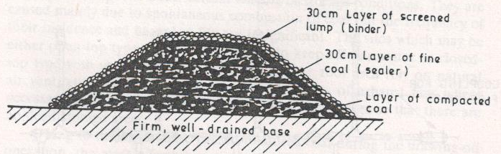
Laying out stack
Flat-topped rectangular piles should be preferred for ease working with heavy mobile equipment.
The fine coal are stacked in no. of layers of 30 to 60 cm thickness.
Each layer is compacted with rubber-tyred equipment to eliminate all air spaces.
AIRTIGHT CAPPING OF A PILE

Slide 15
Sides of the pile should have as gentle a slope as space limitations permit.
Generally, the inclination should be about 35⁰.
Sides as well as the top of the pile should be carefully compacted.
Top of the pile should be finished with a slight crown to help the shedding of water.
Finally, the whole pile is capped or sealed with an airtight covering so that air does not flow into and out of the pile.

Slide 16
Supervision
The temperature of the pile should be checked at regular interval using
  Max. reading thermometer or
  By inserting a series of thermocouples into the piles.
When temp. reading is less than 35 ºC, temp. readings may be taken fortnightly.
When it exceeds 35 ºC, readings may be taken weekly.

Slide 17
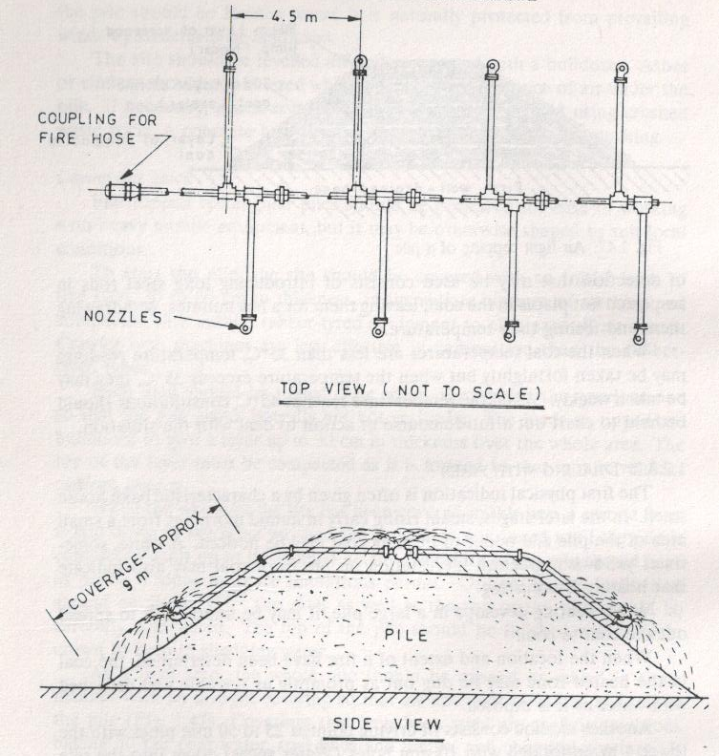
Dealing with coal-stack fires
By digging out coal from heating zone and quenching with water.
By continuous water spraying.

Slide 18
Fires in coal storage silos

Slide 19
Fires may take place in ROM coal storage bunkers and silos which are usually of 15 to 30 m dia and 20 to 60 m high.
They are caused due to spontaneous combustion.
Coal silo fires can be effectively detected by use of gaseous products of combustion detectors for measurement of CO and CO2.
Water is the most effective fire extinguishing agent for suppressing fires within a coal silo.
Water pipeline system with fixed water spray nozzles can be made for the purpose.

